Slide 1
SCOREBOARD and GAMESCREEN

Slide 2
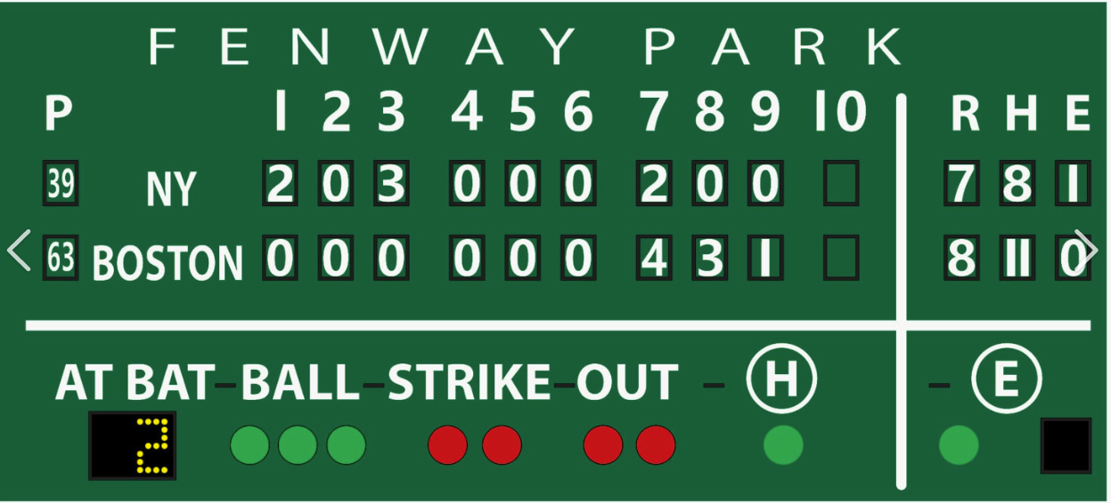



Slide 3
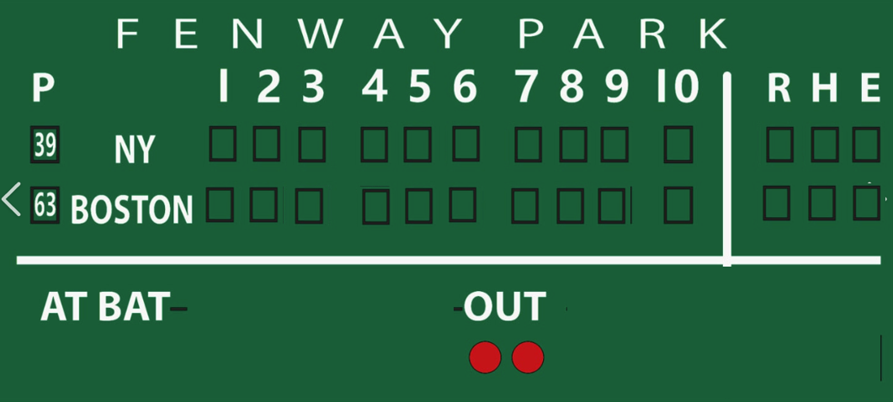

Slide 4





Slide 5
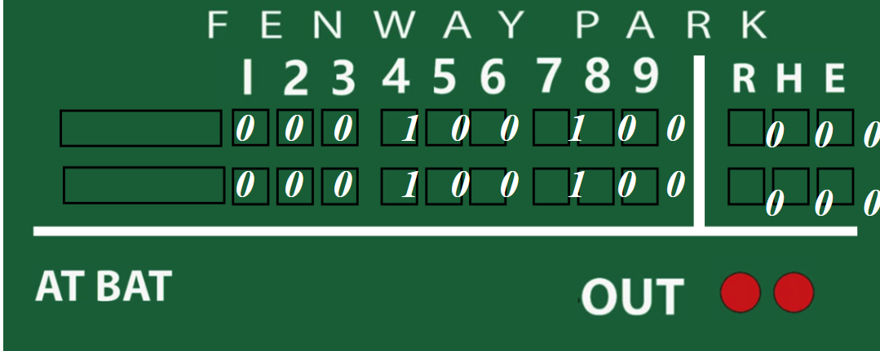
DON’T CHANGE

Slide 7
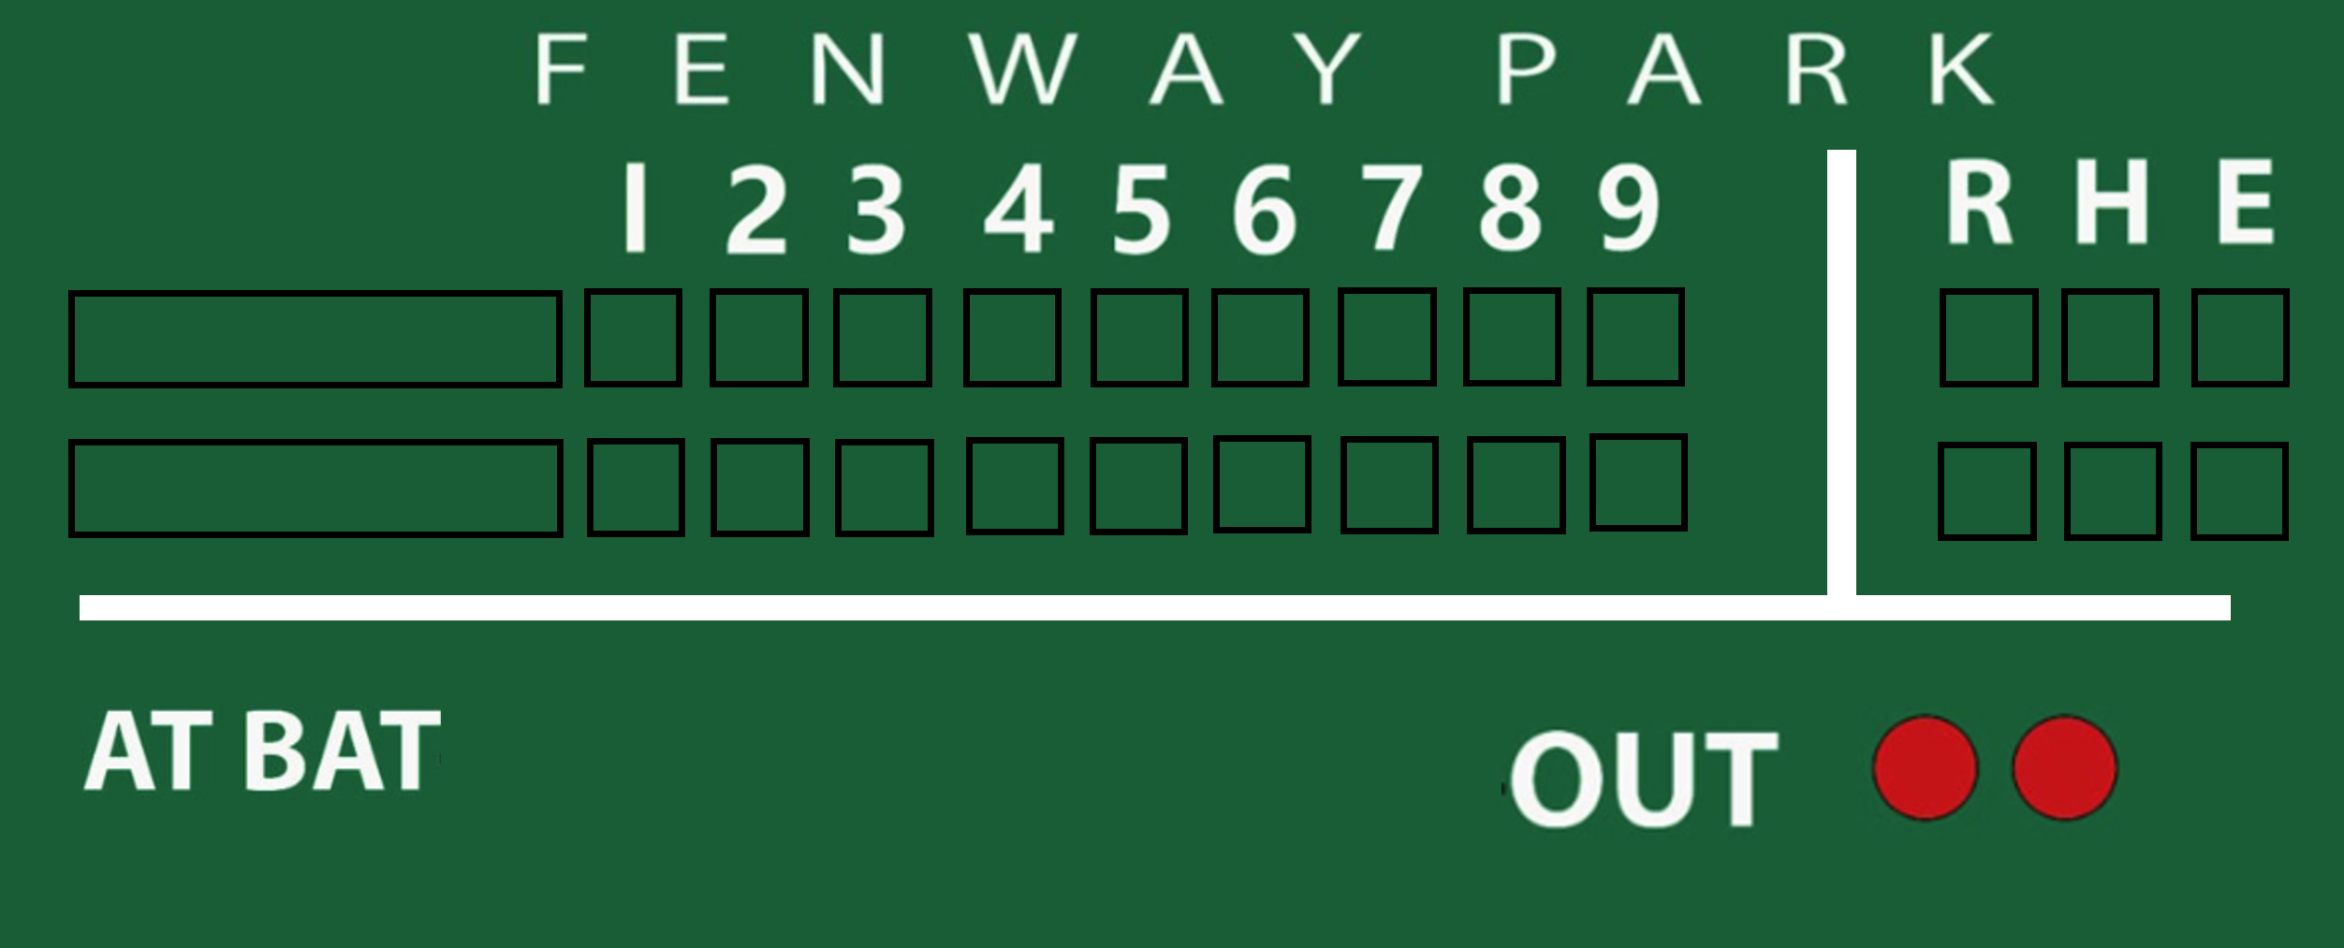
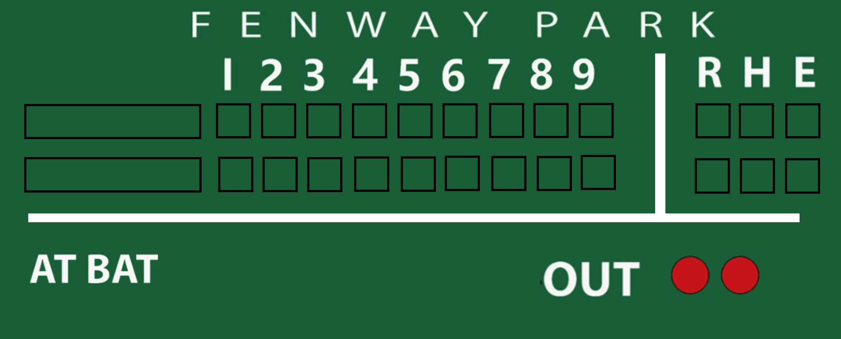

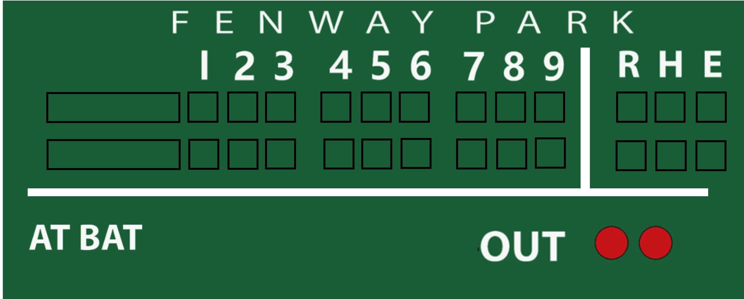
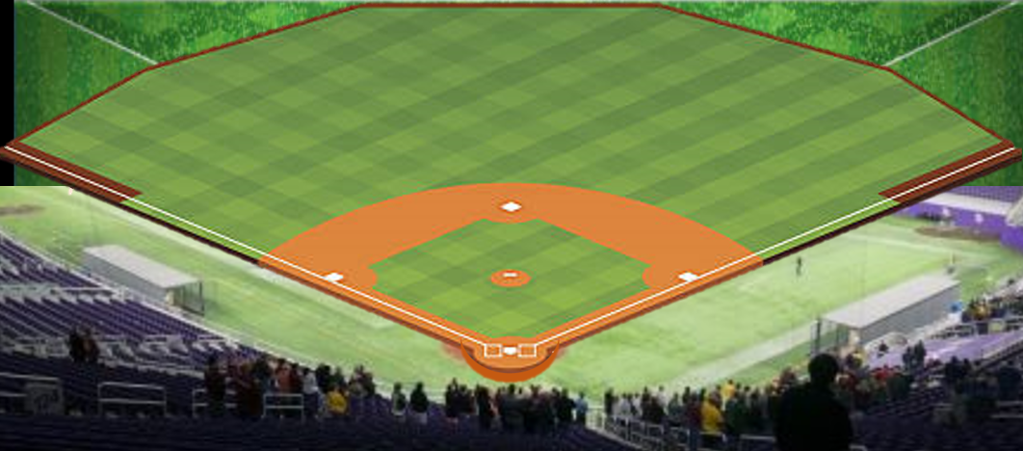
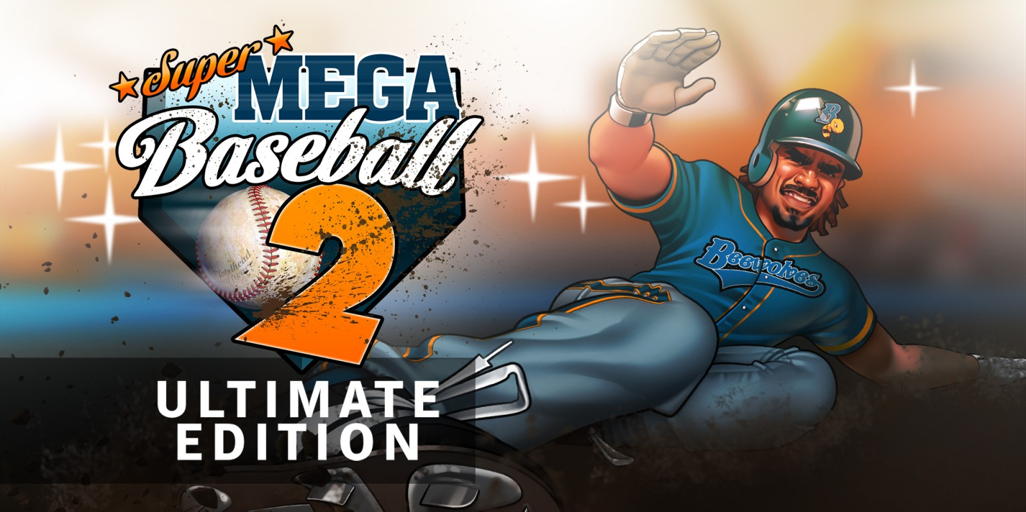

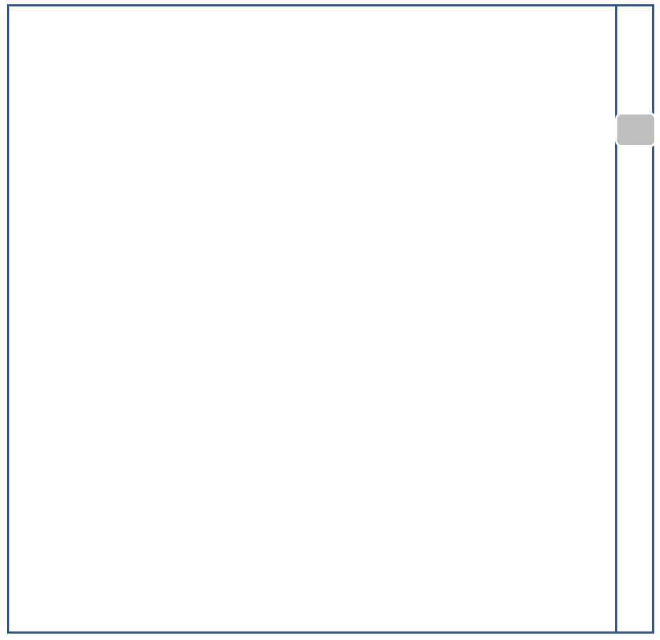
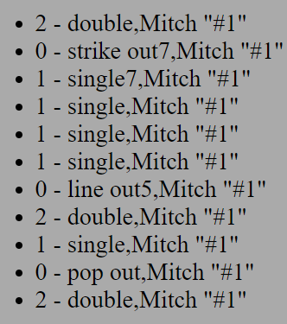
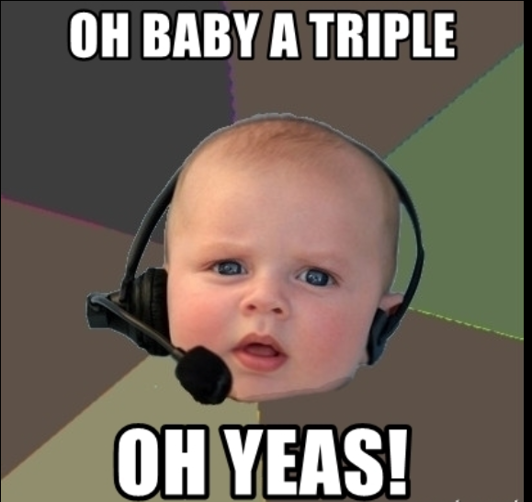
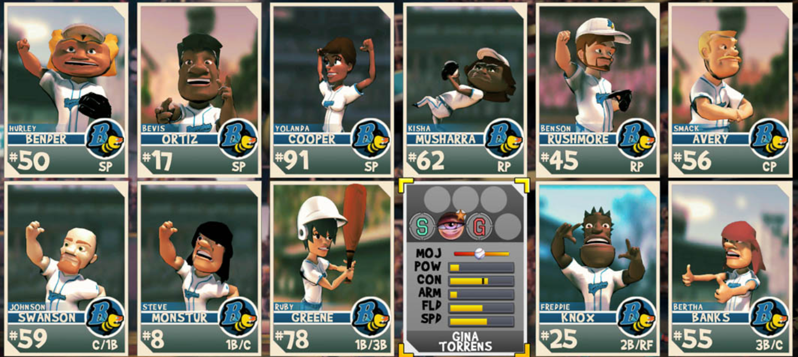
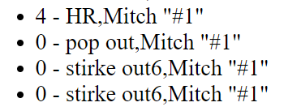
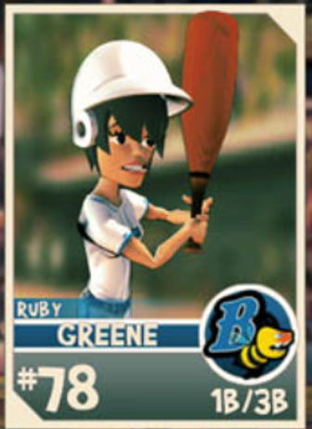
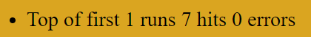
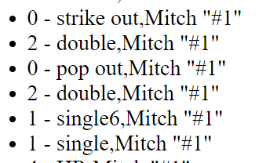
MDM Sports
(TM 2023)
Monday Match up
Play by Play
Pitching
ERA:
.333
Pitching Type:
Power
Today:
?????
Smith
Batting
Season Avg:
.333
Hitter Type:
Power
Today:
2 for 5
Jones

Slide 8
MDM Sports
Giants
0 1 0
(TM 2023)
Dodgers
Monday Match up
Play by Play
Pitching
ERA:
.333
Pitching Type:
Power
Today:
?????
Smith
Batting
Season Avg:
.333
Hitter Type:
Power
Today:
2 for 5
Jones

